Slide 1
Welcome Everyone
Hope all of you enjoy our project

Slide 2

FORUM FOR OUR SPECIAL CHILD

Slide 3
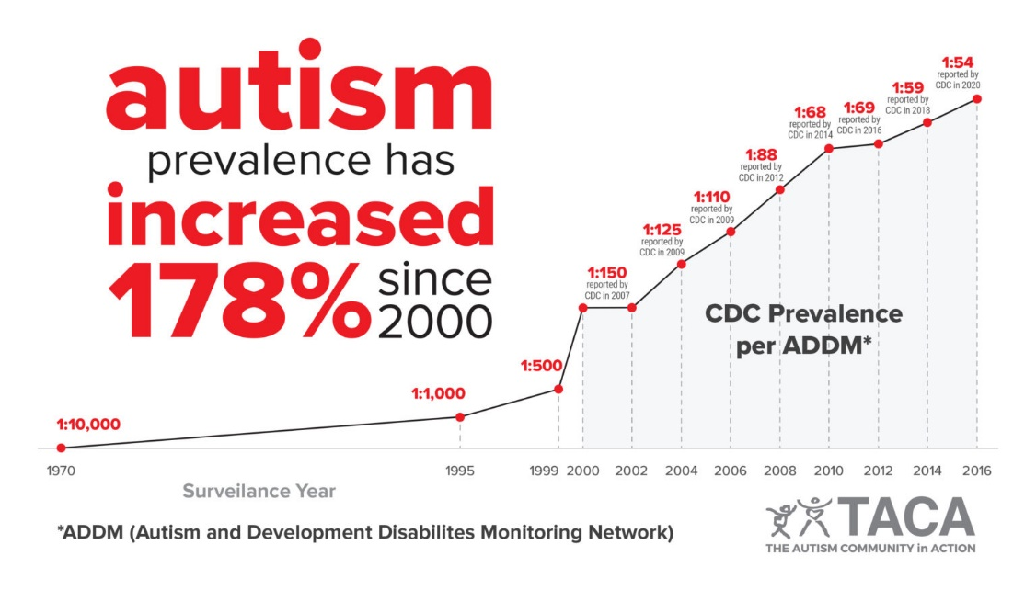
Why we select this idea?
1% in 1.5 lakh peoples are autistic and Male female ratio is 4:1
‘ Finding Doctor, School,
Donation Problem’

Slide 4
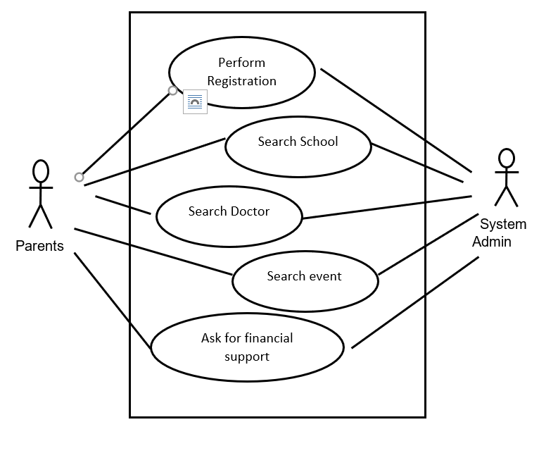
UseCase Diagram

Slide 5
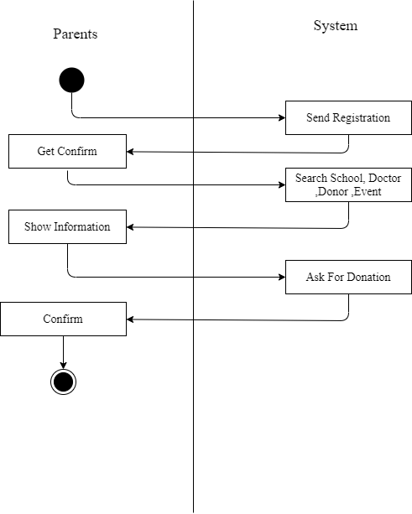
Activity Diagram

Slide 6
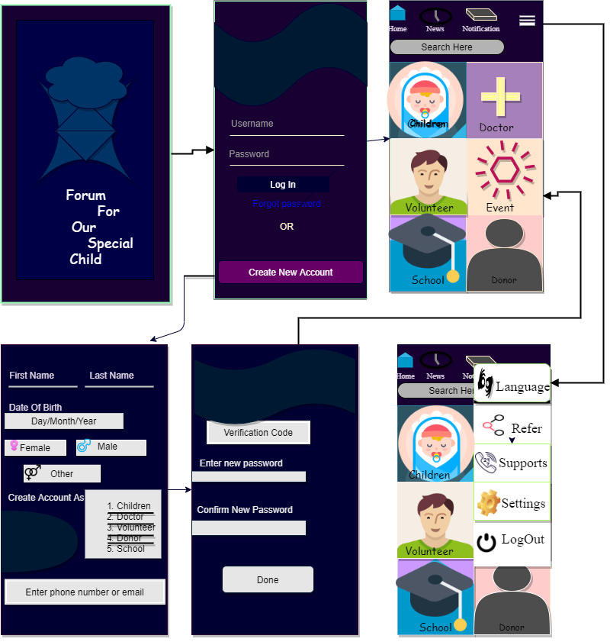
USER INTERFACE DESIGN

Slide 7
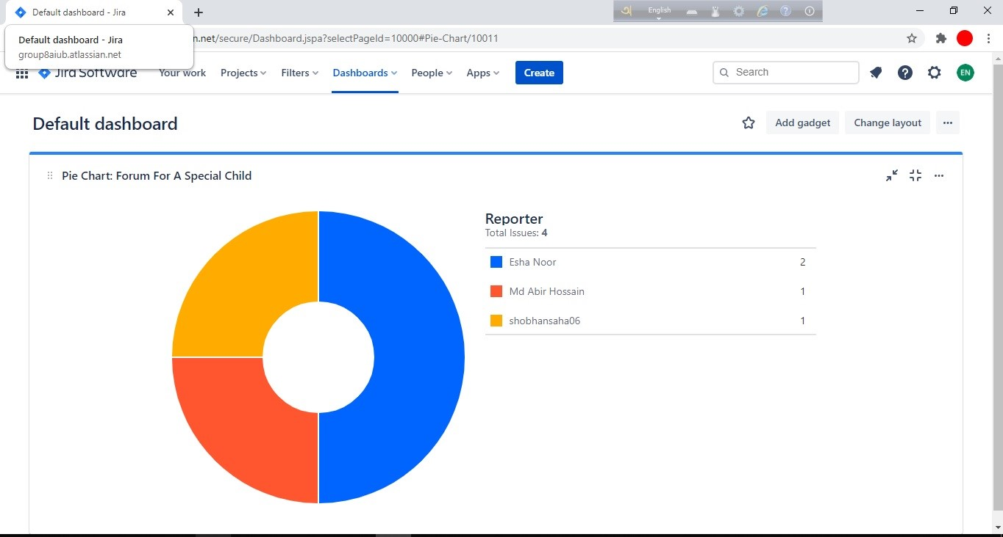
JIRA SOFTWARE

Slide 8
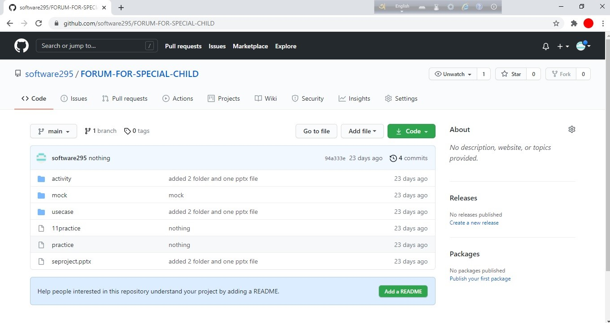
GITHUB

Slide 9
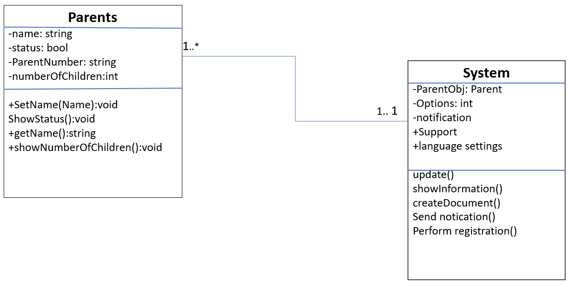
CLASS Diagram

Slide 10
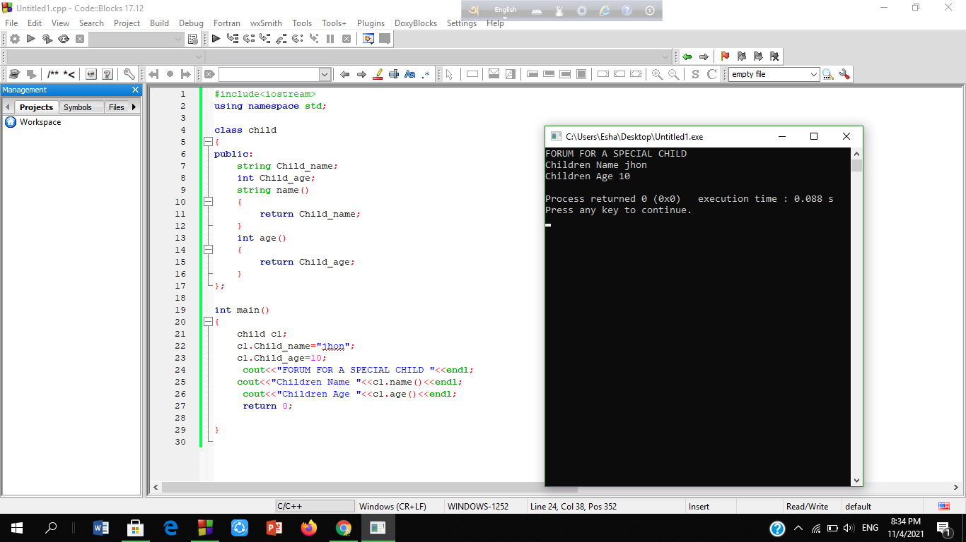
CODING

Slide 11
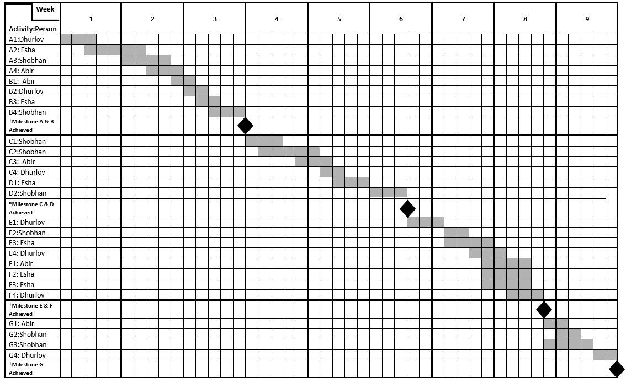
PROJECT SCHEDULING

Slide 12
.
A: Requirement Analysis
A1: Requirement Meetings with Client A2: Identify needs and benefits A3: Communication with stakeholders A4: Establish Product Statements
B: Designing
B1: Use Case Diagram B2: Activity Diagram B3: Mock Design B4: Class Diagram
C: Coding Part
C1: Development and Integrate System Module C2: Boundary Class C3: Entity Class C4: Control Class
D: Implementation
D1: On-Site installation D2: Support Plan for the System
E: Testing Part
E1: Perform Initial Testing E2: Integration Testing E3: System Testing E4: Correct Issues found
F: Documentation
F1: Document Current System F2: User manual F3: Review Scope with the customer F4: Revise Document as Required
G: Maintenance
G1: Fixing the bug and performance issues G2: Taking Feedbacks and working on them G3: Understand Complexity G4: Add new Features

Slide 13
Constructive cost model
project type : Organic
Coefficient<Effort Factor> : 2.4 ;
P=1.05;
T=0.38
SLOC : 13,000 Lines Person Months,
PM ={2.4*(13,000 /1000)^{1.05}} = 35.47
Dev.Time, DM =(2.5 x35.47.38) = 9.702 = 9months = 1672working Hours
Required People, ST =PM/DM = 3.65 =4people

Slide 14
Budgeting:
Developer Salary in 10 months : Pre Developer salary Per Working Hours = 700 Taka
Total Developer salary = 700 x 1672 = 1170400Taka
Requirement Analysis:
Time Needed: 1month (22working Days = 176 Working Hours )
Req Analysis Person’s Hourly wage = 350 Taka
Total Req Analysis Expense =350 x 176 = 61,600 Taka
Transportation Cost Estimation : 9,000 Taka
Training & Hardware Expenses Estimation: 120,000 Taka
Rent Expenses: Room per Month = 10,000 Taka
Total in 10 Months = 100,000 Taka
Total Utilities in 10 Months : 35,000 Taka
Maintaince (Till 7 Months after Delivery): Expense Per Hour = 1000 Taka
Total Estimated time Needed for Maintenance = 70Hours
Total Estimated Maintenance Expense = 70 * 1000 = 70,000 Taka
Other Human Resources: 50,000 Taka
Subscription fee: 15000 Taka
Total Estimated Expense: 1170400+61,600+9,000 +120,000+100,000+35,000+70,000 +50,000+15000= 16,31000
Profit: 35% of Total Estimated Expenses = 1631000* 35% = 570850Taka
Total Budgeting: 1631000+570850=22,01850Taka

Slide 15
Conclution:
To assist children parents with specialized healthcare needs.
Software mangememt.
Focus basic needs.

Slide 16
Thank You Everyone Presented by (Group 8) : 1. Esha, Nura Solahin(19-39767-1) 2. Saha, Shobhan Kuman(19-40911-2) 3. Paul, Durlov(19-39950-1) 4. Hossain, Abir(19-40907-2) Presented to: Dr Razib Hayat Khan Sir Assistant Professor , CS American International University - Bangladesh

